Slide 1
Display Memory
Chapter 6 - Textbook

Slide 2
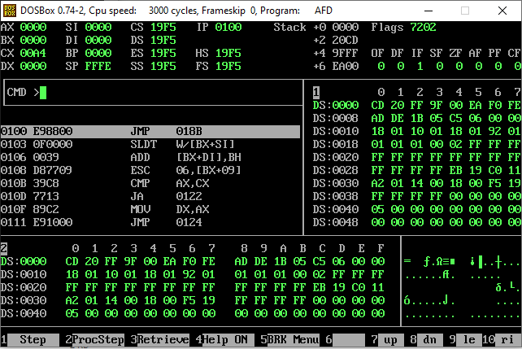
Display Memory

Slide 3
Display Memory
← 80 Columns →
 | 0 | 1 | 2 | … | j | … | 77 | 78 | 79
0 | (0,0) | (0,1) | (0,2) |  |  |  |  |  | (0,79)
1 | (1,0)
2 | (2,0)
...
…
i |  |  |  |  | (i, j)
…
…
22
23
24 | (24,0) |  |  |  |  |  |  |  | (24,79)
Display Memory is a 2-D array of 25x80 Cells.
We can write one character in each Cell.
← 25 Rows →

Slide 4
Display Memory
← 80 Columns →
 | 0 | 1 | 2 | … | j | … | 77 | 78 | 79
0 | (0,0) | (0,1) | (0,2) |  |  |  |  |  | (0,79)
1 | (1,0)
2 | (2,0)
...
…
i |  |  |  |  | (i, j)
…
…
22
23
24 | (24,0) |  |  |  |  |  |  |  | (24,79)
← 25 Rows →
1 Word
Size of each Cell is 1 Word.
So this is an Array of
25 x 80 Words
How much maximum space we need to save a character?

Slide 5
Display Memory
← 80 Columns →
 | 0 | 1 | 2 | … | j | … | 77 | 78 | 79
0 | (0,0) | (0,1) | (0,2) |  |  |  |  |  | (0,79)
1 | (1,0)
2 | (2,0)
...
…
i |  |  |  |  | (i, j)
…
…
22
23
24 | (24,0) |  |  |  |  |  |  |  | (24,79)
← 25 Rows →
MSB
LSB
1 word = 2 Bytes

Slide 6
Display Memory
← 80 Columns →
 | 0 | 1 | 2 | … | j | … | 77 | 78 | 79
0 | (0,0) | (0,1) | (0,2) |  |  |  |  |  | (0,79)
1 | (1,0)
2 | (2,0)
...
…
i |  |  |  |  | (i, j)
…
…
22
23
24 | (24,0) |  |  |  |  |  |  |  | (24,79)
1 word = 2 Bytes
← 25 Rows →
Attribute
Byte
Data/
ASCII Code

Slide 7
Display Memory
← 80 Columns →
 | 0 | 1 | 2 | … | j | … | 77 | 78 | 79
0 | A | (0,1) | (0,2) |  |  |  |  |  | (0,79)
1 | (1,0)
2 | (2,0)
...
…
i |  |  |  |  | (i, j)
…
…
22
23
24 | (24,0) |  |  |  |  |  |  |  | (24,79)
1 word = 2 Bytes
← 25 Rows →
Attribute
Byte
Data/
ASCII Code
?
0x41

Slide 8
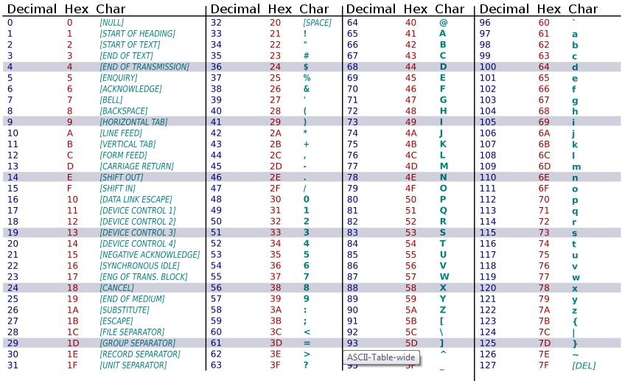
ASCII Table

Slide 9
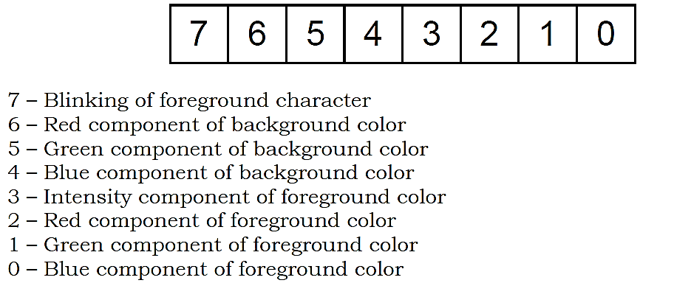
Attribute Byte
0 → Black
Max Color → White
FG | Background |  |  | Foreground
Blink | R | G | B | Intensity | R | G | B
A

Slide 10
Attribute Byte
FG | Background |  |  | Foreground
Blink | R | G | B | Intensity | R | G | B
1 | 0 | 0 | 0 | 1 | 1 | 1 | 1
A

Slide 11
Display Memory
← 80 Columns →
 | 0 | 1 | 2 | … | j | … | 77 | 78 | 79
0 | B8000 | B8002 | B8004 | … |  |  |  |  | X
1 | X+2 | X+4 | X+6 |  |  |  |  |  | X+160
2
...
…
i
…
…
22
23
24
Display Memory region starts at Physical Address 0xB8000.
Everything that you write at this Memory will be visible on screen.
← 25 Rows →

Slide 12
Desired Screen Location (r,c)
← 80 Columns →
 | 0 | 1 | 2 | … | c | … | 77 | 78 | 79
0 | 0 | 1 | 2 | … |  |  |  |  | 79
1 | 80x1
2 | 80x2
3 | 80x3
…
r | 80xr | +1 | +2 |  | +c
…
…
22
23
24
Word No.
← 25 Rows →
Word No.
(80 x r) + c
Byte No.
((80xr)+c)x2
Logical Address:
B800: ((80xr)+c)x2

